Slide 1
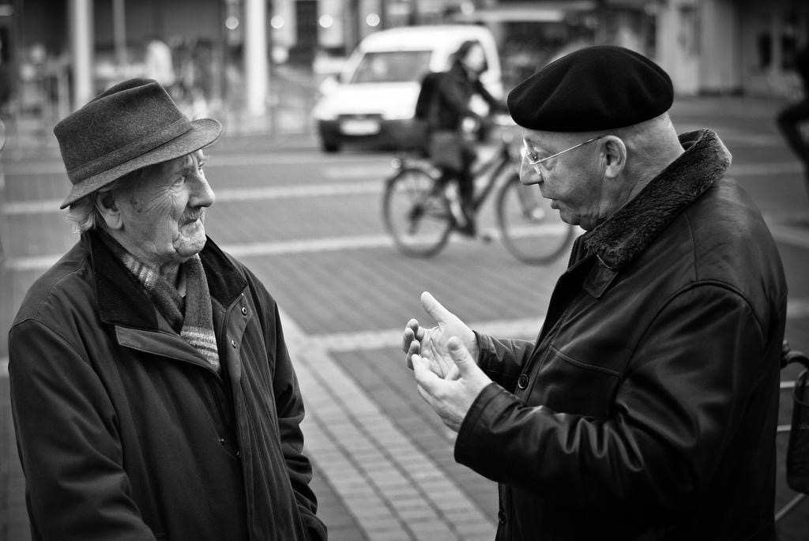
English conversation 1

Slide 2
I love all sort of music. Rock, pop, ballads and so on.
Anyone can do that. It´s not that hard.
Can I have a piece of that whatisname?
That guy is kind of weird, he…erm…I don’t know…has that look…you know.
What a shame! It’s closed. I wonder if they will open later.
Nevermind. There’s no hurry.

Slide 3
What is missing in this dialogue?
Have you seen Professor Smith?
_____ I saw her in the office, ___ she was in a meeting.
_____? I need her urgently. ______, did you hand in the homework?
_______? Was there homework?

Slide 4
What is missing in this dialogue?
Have you seen the Professor Smith?
I think I saw her in the office, but she was in a meeting.
Really? I need her urgently. By the way, did you hand in the homework?
What? Was there homework?

Slide 5
Discourse markers
We use these to organise our texts - in writing and in speaking
Using discourse markers well makes a text more natural - not using them (or using them wrongly) makes a speaker sound unnatural

Slide 6
Discourse markers
Ok, now, we are going to talk about the evaluation.
Oh, that’s wonderful.
Well, I think that’s all for now.
Time is off, so I’ll pass picking up the papers.
She’s nice, but her mother is a witch.
This is mine; I mean, I bougth it.

Slide 7
Discourse markers
Now: signals the initiation of a new idea.
Oh: signals amazement or surprise.
Well: signals the initiation of a turn.
So: signals the consequence of the previous idea. (or …..?)
But: signals a contrasting idea.
I mean: signals clarification.

Slide 8
Discourse markers
“They serve to show that what is being said is connected to what has been said” (Schifrin, 1997).
In a speaker’s turn or across speakers’ turns.
Local level: Linking adjacent utterances
Global level: Segmenting larger chunks in discourse.

Slide 9
Discourse markers
Conversational transitions: By the way, in fact, that is, that reminds me, etc.
Overtures: I would have thought, Like I say, The question is, There again, What we can do is, You mean to say, Going back to, etc. (They serve to launch utterances)
Tails: Though, actually, anyway, I guess. (Tag questions and vague identifiers also form part of this category)

Slide 10
Interactional signals
Signals that permit cooperation in interaction.
Attention signals: Hey! Buddy! Look out!
Response elicitors: Right? Ok? Eh? So?
Backchannels: Feedback to the speaker (mm, uh huh, really?, no kidding!)

Slide 11
Categorize these expressions:
DISCOURSE MARKERS:
CONNECTORS
TRANSITIONS
OVERTURES
TAILS
INTERACTIONAL SIGNALS:
BACKCHANNELS
RESPONSE ELICITORS
ATTENTION SIGNALS

Slide 12
More discourse markers
As I was saying…
Anyway,
Here’s the thing, / The thing is,
I’m glad you brought that up because…
At the end of the day, (to conclude)

Slide 13
More discourse markers
Actually,
Apparently,
As for…
Basically,
By the way,
Let’s see,
I mean,
On the other hand,
Speaking of…
Taken from http://englishspeak.wpengine.com/discourse-markers-useful-expressions-for-english-conversation-part-1/

Slide 14
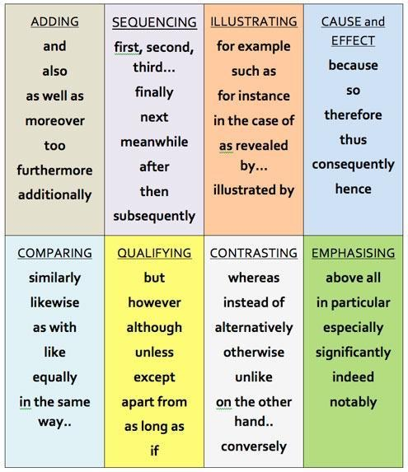
More discourse markers
Taken from http://www.bubblews.com/news/384100-discourse-markers-list

