Slide 1
From Storytelling to focus-on-form
Michael Carroll, Momoyama Gakuin University, Osaka

Slide 2
Telling stories? It would be nice, if only we had the time.

Slide 3
Stories are everywhere

Slide 4
Engage-Study-Activate
(Jeremy Harmer)
engage learners’ interest
focus on specific grammar study
activate new knowledges

Slide 5
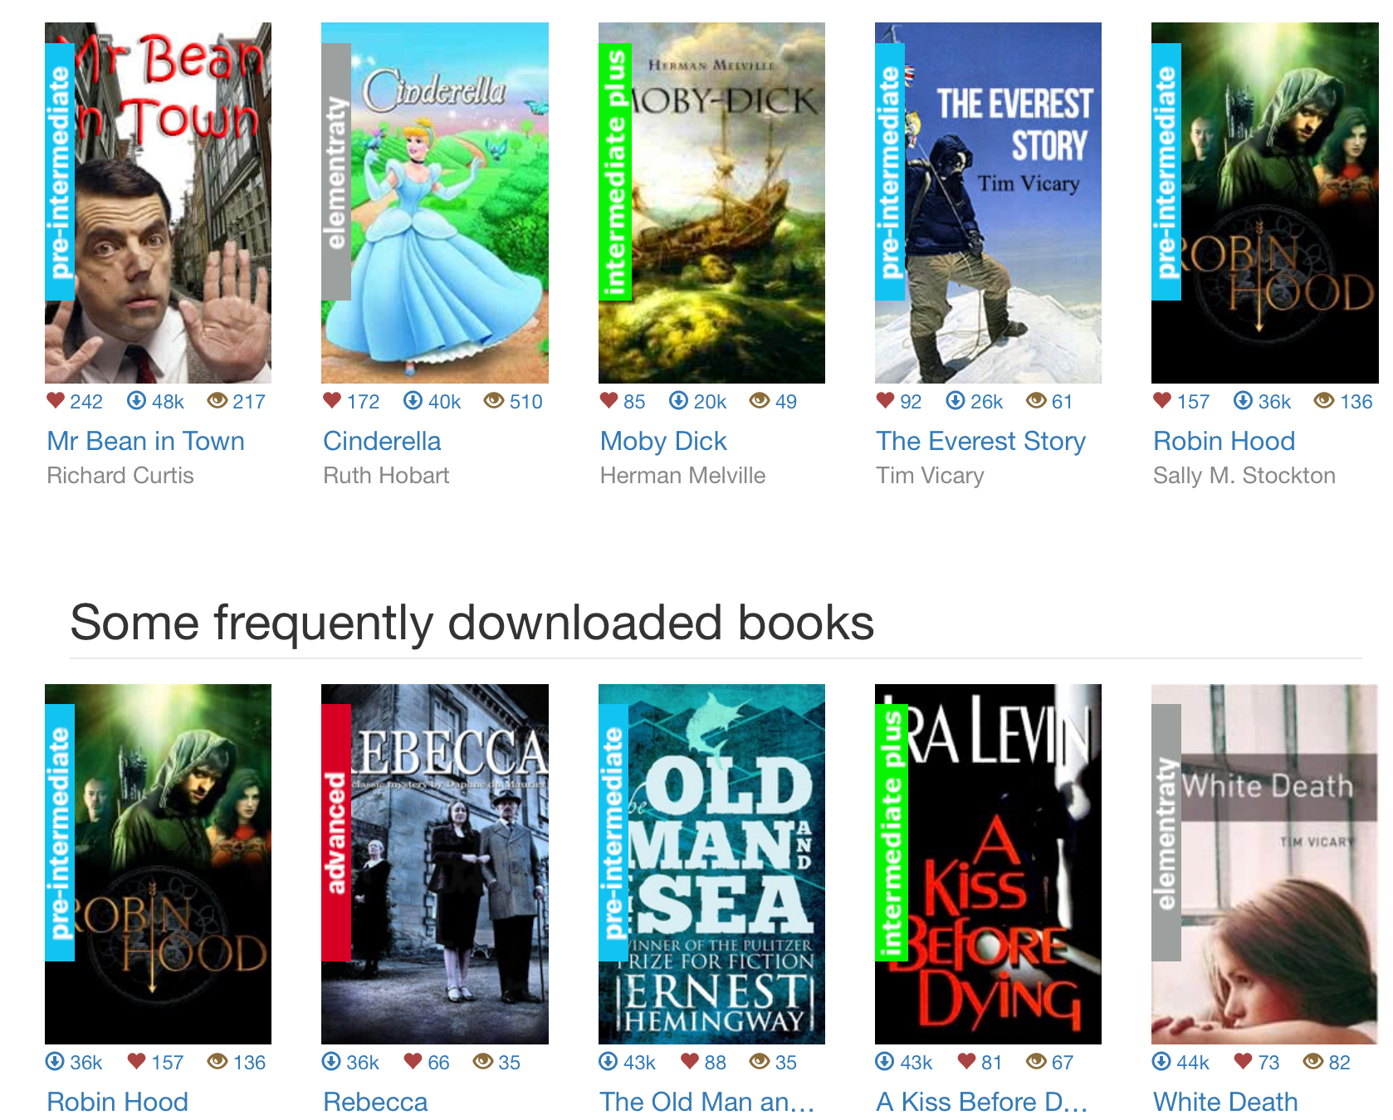

Slide 6
A man and his son were driving home from a party. It was a dark, rainy night. As they drove, suddenly a cat ran in front of the car. The man hit the brakes and skidded on the wet road. The car swerved off the road and crashed right into a large tree. The man was killed instantly.
An ambulance came, and rushed the boy to hospital. In the hospital, the boy was taken into the operating theatre. The surgeon came in, looked at the boy, and cried, “Oh no, my son!”
How come?

Slide 7
Pu-yi 溥仪 (February 7, 1906–October 17, 1967) was the last Emperor of China. He was crowned emperor in 1908 at the age of three. He married five times but never had any children. His father was Zaifeng Prince Chun II. He never knew his mother and was raised by eunuchs.
At the age of six, he was overthrown by Sun Yat-sen in the 1911 Revolution, and he was never allowed to leave the Forbidden City.
While he was living in the Forbidden City, in the year 1919, Pu-yi appointed a British tutor. Through him that the young emperor developed a fascination with the Western world, so he began to adopt aspects of the West for himself. He learned how to ride a bicycle, he cut off his own Manchu queue (the hair at the back of his head), and he even began to wear glasses.

Slide 8
I want to the park yesterday. It was very fun. I got 10 fish. 5 was little big 5 of them was big. I keep 5 of the little fish. When I pell the fish up I amost fell into the water but my dad grabbed my shirt.

Slide 9
Stories, narratives, recounts
…..
are everywhere in daily conversation
Guess what happened last Tuesday?
I was just getting on the train this morning, and (suddenly) ….

Slide 10
Grammar
=
how we put words together to communicate meaning

Slide 11
Stories have structure (narrative structure: the grammar of narrative)
(Grammar = how we put words together to make meaning)

Slide 12
we can teach this structure

Slide 13
The grammar of stories
(narrative grammar)
This is easy for most learners
Stories have a foreground
(what happens - simple past tense)
and a background
(what we need to know about the situation to understand the story)
This is difficult: knowing what the listener doesn’t know

Slide 14
Who, where, when
Background:

Slide 15
(what, why, how
are
foreground)

Slide 16
ALL stories have the same structure
foreground
and
background

Slide 17
... they also have endings

Slide 18
Story endings are sometimes called
denouement, resolution,
reflection

Slide 19
Narrative structure (the grammar of stories)
See Labov (1967)
Orientation (when and where the story happened; who did the story happen to)
Sequence of events (foreground: what happened)
Resolution (what happened in the end; what did the story mean?)
for a genre based account of the grammar of narrative click here
For a more complete description of narrative structure click here

Slide 20
ALL stories AT ALL LEVELS have the same (basic) sentence grammar, too
(the difference between levels is in vocabulary, and complexity)

Slide 21
The (sentence) grammar used in telling stories
stative and progressive verbs
past tense verbs (usually simple past, but also past perfect, past progressive)
adverbs referring to (past) time
chronological order (this … then this … then this ….)
proper nouns (names of people and places) ; pronouns (he, she, it, I , you, we)

Slide 22
Orientation stative verbs ; progressive verb forms ; temporal conjunctions
Sequence of events action verbs ; reflection verbs ; temporal conjunctions ; cause and effect
Resolution stative verbs, reflection verbs

Slide 23
Orientation stative verbs ; progressive verb forms ; adverbs of time
Sequence of events action verbs ; reflection verbs ; adverbs of time ; cause and effect
Resolution stative verbs, reflection verbs
It was a dark night … I was walking along the street … then, after that …
A cat ran across the road … the car crashed … I thought …. I realised …
He was not badly hurt … I was annoyed that I was late … I felt tired out ….

Slide 24
A man and his son were driving home from a party. It was a dark, rainy night. As they drove, suddenly a cat ran in front of the car. The man hit the brakes and skidded on the wet road. The car swerved off the road and crashed right into a large tree. The man was killed instantly.
An ambulance came, and rushed the boy to hospital. In the hospital, the boy was taken into the operating theatre. The surgeon came in, looked at the boy, and cried, “Oh no, my son!”
How come?
Orientation, sequence of events, resolution?

Slide 25
Theatre journals
Excerpt from one student’s journal:
How the Boy Caught Ten Fish
(1) I went to the park yesterday. (2) It was very fun. (3) I got 10 fish. (4) 5 was little big (5) 5 of them was big. (6) I keep 5 of the little fish. (7) When I pell the fish up I amost fell into the water but my dad gabblet my shert. (11-12-98)
(From Ellen Lipp, 2001, “Building a Cross-Cultural Community of Learners and Writers through Pen Pal Journals”, in Burton J and Carroll M (eds) Journal Writing TESOL Publications. )

Slide 26
Who did the boy go with?
What was the weather like?
What were the boy and his father going to do at the park?
What happened next?
(1) I went to the park yesterday. (2) It was very fun. (3) I got 10 fish. (4) 5 was little big (5) 5 of them was big. (6) I keep 5 of the little fish. (7) When I pell the fish up I amost fell into the water but my dad gabblet my shert. (11-12-98)

Slide 27
Expanded narrative:
(1) I went to the park yesterday with my dad. It was a sunny day. We were going to go fishing. (2) It was very fun. (3) I got 10 fish. (4) 5 was quite big (5) 5 of them was very big. (6) I kept 5 of the little fish. (7) When I pulled the fish up I almost fell into the water but my dad grabbed my shirt. I didn’t fall in. We went home.
(1) I went to the park yesterday. (2) It was very fun. (3) I got 10 fish. (4) 5 was little big (5) 5 of them was big. (6) I keep 5 of the little fish. (7) When I pell the fish up I amost fell into the water but my dad gabblet my shert. (11-12-98)

Slide 28
How do students learn grammar from this?
First, they learn, from the questions, that communicating more precise meaning is important
Second, they learn that some errors are more important than others:
pell ——> pulled
gabblet ——-> grabbed
little big ——-> quite big (vs very big)

Slide 29
Summary
everyone likes telling stories, so they motivate learners
grammar is an integral part of telling stories, if we see grammar as “how we put words together to make meaning”

